Slide 1
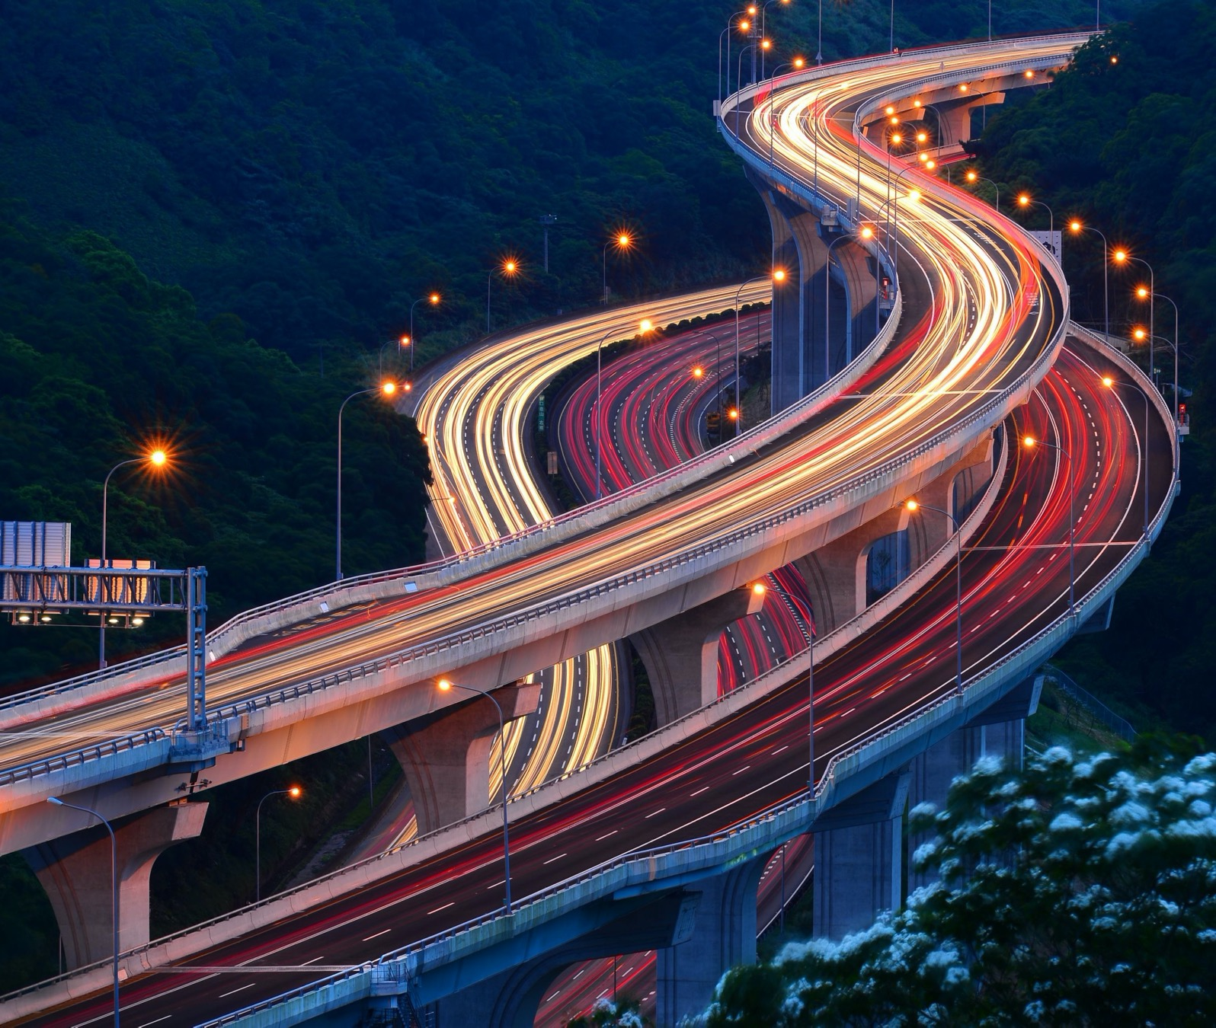
Architecture: Scheduler Appendix: Timezone 2022/07/20 Jesse Wei IBM Services

Slide 2
Agenda – Architecture: Scheduler: Timezone
Background
Time zone introduction
Time zone in computer system
Time zone in Python
Time zone in Airflow
Time zone special issue
Q&A

Slide 3
Agenda – Architecture: Scheduler: Timezone
Background
Time zone introduction
Time zone in computer system
Time zone in Python
Time zone in Airflow
Time zone special issue
Q&A

Slide 4


Data Architecture
- Data pipeline in stage view
參考架構: 數據平台, ODP: Operational Data Platform
使用單位
使用領域
負責領域
開發技術
OSS
CDC
ODS
INT
DM
APP
Stage
Operational Support System
ERP
MES
dbLink
CRM
其他
Change Data Capture
File
dbLink
數據平台/ SQL server
報表工具
Drop Zone
DM
SRC
STG
Landing Zone
ODS
Integration Zone
Public Zone
INT
Domain
Tableau Server
Tableau / Web
Tableau Desktop
File
Notes:
STG / ODS/ INT / DM

Slide 5
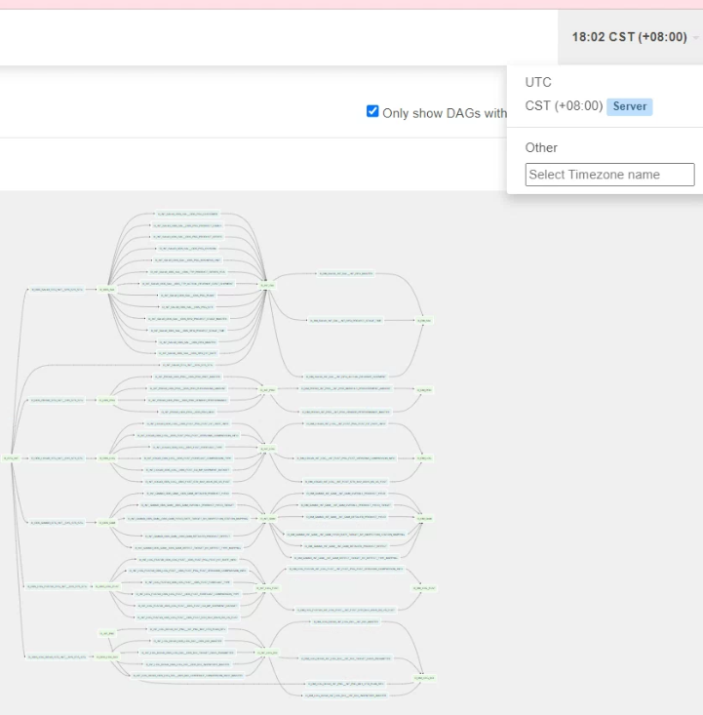
Requirement
Issue:
Why END_DT_CHAR = logical date -2?
Why D_ODS_SAL external sensor skipped?
Requirement
How to setup time zone in UI or any date field?
How to arrange schedule job and align between global office?
Notes:
Why “TypeError: tzinfo argument must be None or of a tzinfo subclass, not type 'str’”?

Slide 6
Agenda – Architecture: Scheduler: Timezone
Background
Time zone introduction
Time zone in computer system
Time zone in Python
Time zone in Airflow
Time zone special issue
Q&A

Slide 7
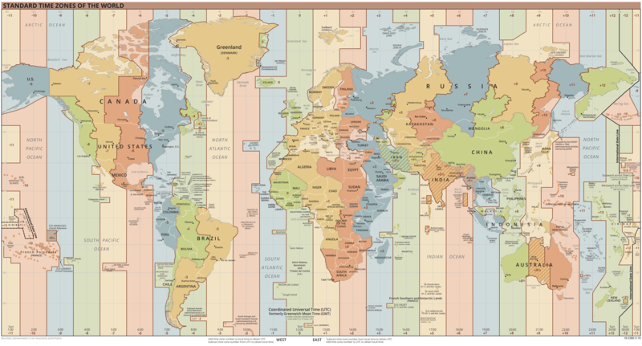
理論時區, 法定時區

Slide 8
Time Zones
The world is divided into 24 time zones.
https://en.wikipedia.org/wiki/Time_zone
理論時區, Nautical time zones
就是以經線間隔 15 度為一個區間，以區間的中央經線的時間為該時區的時間（比如：台灣所使用的東八區時區，就是東經 120 度經線的東西兩側延伸 7.5 度範圍，即西經 112.5 度至東經 127.5 度之間。）所以每差一個時區，區時相差一個小時。
法定時區, Skewing of time zones
統一整個國家的時間，方便政府管理，以國界或國家內部行政分界線區分時區
UTC
Universal Coordinated Time: UTC (Similar to historical Greenwich Mean Time)
Time and date are meaningless without timezone
身為生活長期同時區消費者, 環境已經預設(廠商/顧問), 不用煩惱時區. 但,
如果, 身為顧問
要提供跨時區自動服務, 像幫全球office 設ETL;
使用免費商品(例如, open source ), 預設UTC+0時,
Process time and date need to know TZ
Notes:
簡稱 UTC,

Slide 9

Time Zones
The world is divided into 24 time zones.
Approximately how many degrees of longitude divide each time zone?
Hint: The world is divided into 360⁰.
ANS:
The North Carolina Geographic Alliance http://geo.appstate.edu/NCGA
Notes:
Ans: approximately 15⁰ per time zone

Slide 10
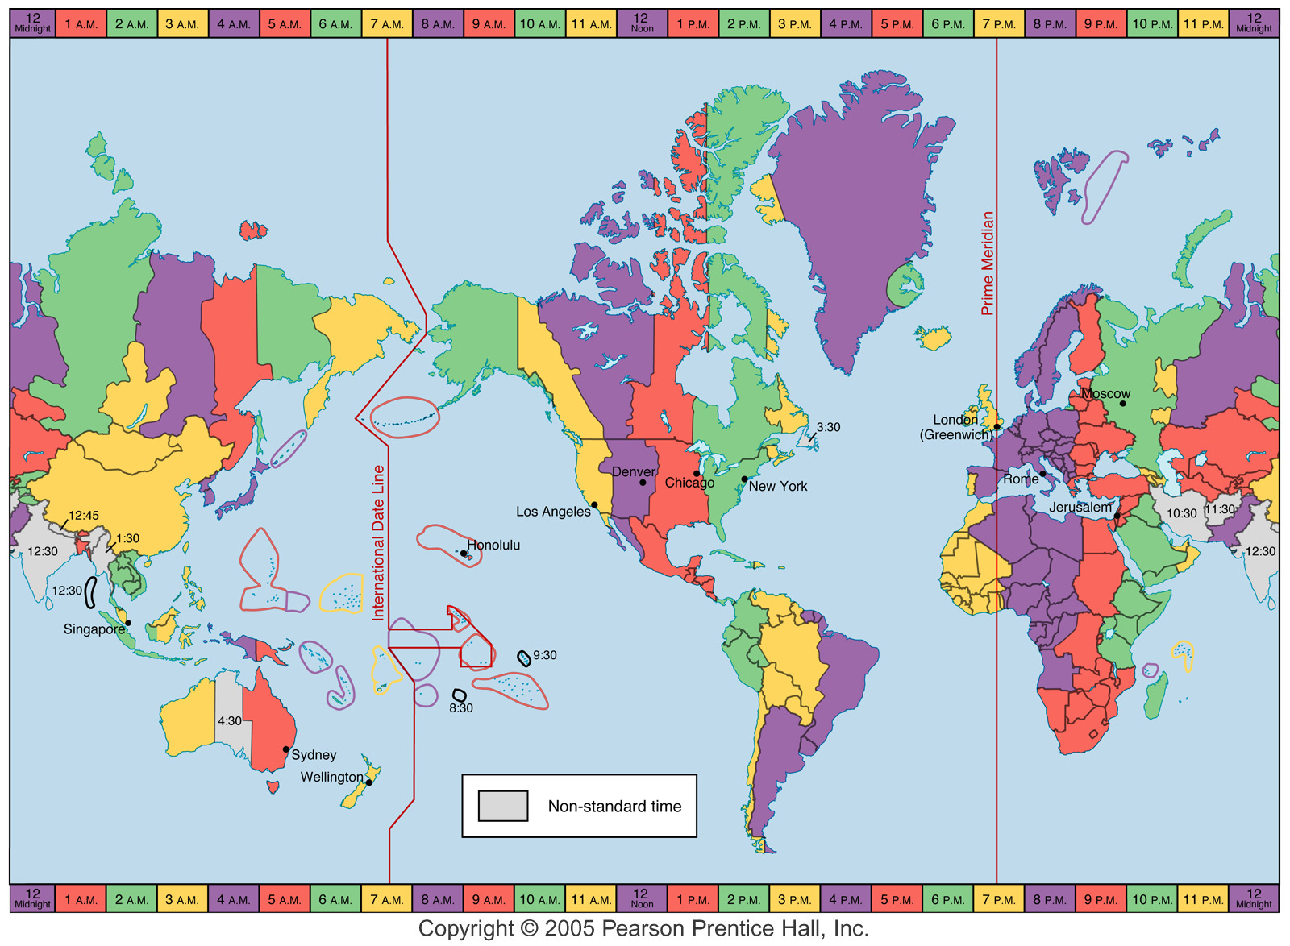
Meet the Map
The Prime Meridian is 0⁰ longitude

Slide 11
Meet the Map
The Prime Meridian is 0⁰ longitude
The International Date Line is 180⁰ longitude

Slide 12
Meet the Map
The Prime Meridian is 0⁰ longitude
The International Date Line is 180⁰ longitude
Color coded time zones

Slide 13
What happens when you travel across the International Date Line?

Slide 14
Gain a Day
What happens when you travel across the International Date Line?

Slide 15
Gain a Day
What happens when you travel across the International Date Line?
Skip a Day

Slide 16
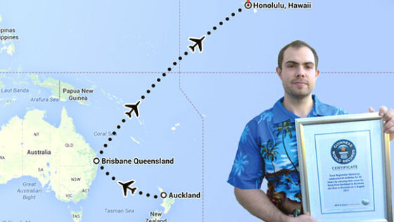
換日線 (International Date Line)
史上生日時間最長的人
2015 年時，一名德國男子哈格邁爾（Sven Hagemeier）46 個小時。
先抵達接近國際換日線的國家：紐西蘭，再從紐西蘭的奧克蘭出發，抵達第二站：比奧克蘭晚兩小時的澳洲布里斯本，最後再搭飛機經過國際換日線抵達比布里斯本晚二十小時的夏威夷檀香山。
千里共嬋娟?
經度 90 度範圍
換日線? 14/15號的月亮?
https://en.wikipedia.org/wiki/International_Date_Line
Notes:
https://pansci.asia/archives/194470

Slide 17
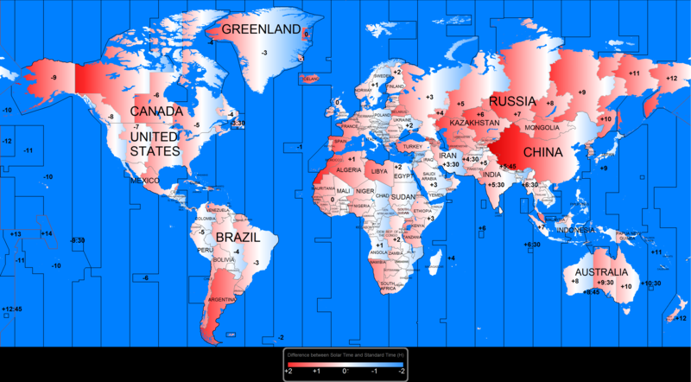
陽光時區差異

Slide 18
Agenda – Architecture: Scheduler: Timezone
Background
Time zone introduction
Time zone in computer system
Time zone in Python
Time zone in Airflow
Time zone special issue
Q&A

Slide 19
Time zone database name
https://en.wikipedia.org/wiki/List_of_tz_database_time_zones
Country code(s) | TZ database name | Area(s) covered | Type | UTC offset ±hh:mm |  | Time zone abbreviation |  | Source file | Notes
 |  |  |  | STD | DST | STD | DST
CI, BF, GH, GM, GN, ML, MR, SH, SL, SN, TG | Africa/Abidjan |  | Canonical | +00:00 | +00:00 | GMT |  | africa
GH | Africa/Accra |  | Link† | +00:00 | +00:00 | GMT |  | africa | Link to Africa/Abidjan
ET | Africa/Addis_Ababa |  | Link† | +03:00 | +03:00 | EAT |  | africa | Link to Africa/Nairobi
DZ | Africa/Algiers |  | Canonical | +01:00 | +01:00 | CET |  | africa
ER | Africa/Asmara |  | Link† | +03:00 | +03:00 | EAT |  | africa | Link to Africa/Nairobi
ER | Africa/Asmera |  | Link | +03:00 | +03:00 | EAT |  | backward | Link to Africa/Nairobi
Etc/GMT-1 in POSIX time zone names, positive offsets are used for locations west of Greenwich. =
UTC+01:00 is an identifier for a time offset from UTC of +01:00. In ISO 8601,
Notes:
https://stackoverflow.com/questions/56217512/in-postgresql-timezone-offset-is-taken-with-the-wrong-sign

Slide 20
Time zone in computer system
Operating systems
Unix
system time in time_t format, representing the number of seconds that have elapsed since 00:00:00 Coordinated Universal Time (UTC) on Thursday, January 1, 1970.
specify time zones using the TZ environment variable, allows users in multiple time zones to use the same computer
Windows, Windows 2000
Before, local time
After, can use UTC as the basic system time
Programming languages
Java
from version 1.3.1, has maintained its own time zone database.
As of Java 8 there is a new date and time API that can help with converting time zones.
JavaScript
little in the way of time zone support
Python
The standard module datetime included, pytz module provides access to the full IANA time zone database.
Negated time zone offset in seconds
From Python 3.9, the zoneinfo module introduces timezone management without need for third party module.
Database
In PostgreSQL timezone offset is taken with the wrong sign?

Slide 21
Time zone in POSIX
TZ 環境變數
std offset
範例： EST+5
std offset dst [offset],start[/time],end[/time]
範例：EST+5EDT,M4.1.0/2,M10.5.0/2
:characters
範例：":/etc/localtime" 或 ":America/New_York"
此 characters 由各個作業系統定義，就 GNU C library 而言，characters 為儲存 timezone 的檔案名稱。
指令
Windows 使用 tzutil
tzutil /g
tzutil /l
tzutil /s "China Standard Time"
Linux
cat /etc/localtime
ls -al /usr/shar/zoneinfo/
ln -sf /usr/share/zoneinfo/EST /etc/localtime
Mac OS
sudo systemsetup -gettimezone
sudo systemsetup -listtimezon
sudo systemsetup -settimezone US/Central
Notes:
http://albert-oma.blogspot.com/2013/10/timezone.html IEEE Std 1003，而國際標準名稱為ISO/IEC 9945

Slide 22
Agenda – Architecture: Scheduler: Timezone
Background
Time zone introduction
Time zone in computer system
Time zone in Python
Time zone in Airflow
Time zone special issue
Q&A

Slide 23
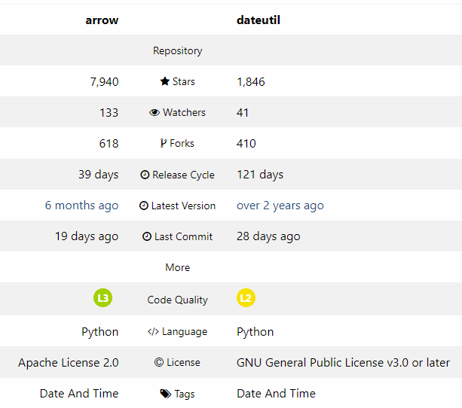
Time zone in python
Standard
Datetime, time
Pendulum
Used by airflow
pytz
Dateutil /Arrow
please-stop-using-arrow
For newcomers it might seem practical, but it only encourages bad practices.
https://docs.python.org/3/

Slide 24
standard library
Python’s standard library
The time module is principally for working with Unix time stamps;the datetime module can support many of the same operations, but provides a more object oriented set of types.
Before 3.9, does not understand time zones and is not generally safe to use for date or time computations.
zoneinfo — IANA time zone support
Introduced in Python 3.9. Available as a backport to Python 3.6+
Provides historical time zone information
Standard open source (public domain) source for time zone information
zoneinfo intro
Exercise: ./test/timezone/standard.py
Directive | Description | Example | Try it
%a | Weekday, short version | Wed | Try it »
%A | Weekday, full version | Wednesday | Try it »
%w | Weekday as a number 0-6, 0 is Sunday | 3 | Try it »
%d | Day of month 01-31 | 31 | Try it »
%b | Month name, short version | Dec | Try it »
%B | Month name, full version | December | Try it »
%m | Month as a number 01-12 | 12 | Try it »
%y | Year, short version, without century | 18 | Try it »
%Y | Year, full version | 2018 | Try it »
%H | Hour 00-23 | 17 | Try it »
%I | Hour 00-12 | 05 | Try it »
%p | AM/PM | PM | Try it »
%M | Minute 00-59 | 41 | Try it »
%S | Second 00-59 | 08 | Try it »
%f | Microsecond 000000-999999 | 548513 | Try it »
%z | UTC offset | +0100
%Z | Timezone | CST
Notes:
https://stackoverflow.com/questions/7479777/difference-between-python-datetime-vs-time-modules

Slide 25
pytz
A Extension for World Timezone Definitions in Python
http://pytz.sourceforge.net/
For standard datetime implementation issue,
need extra transformation API, localize() and normalize()
Exercise: ./test/timezone/pytz-ex.py
ex-1=> Get current Date Time Object
ex-2=> Create Source Time Zone Object
ex-3=> Assign Source Time Zone to Created Date Time Object
ex-4=> Create Target Time Zone Object
ex-5=> Convert Source Time Zone to Target Time Zone

Slide 26
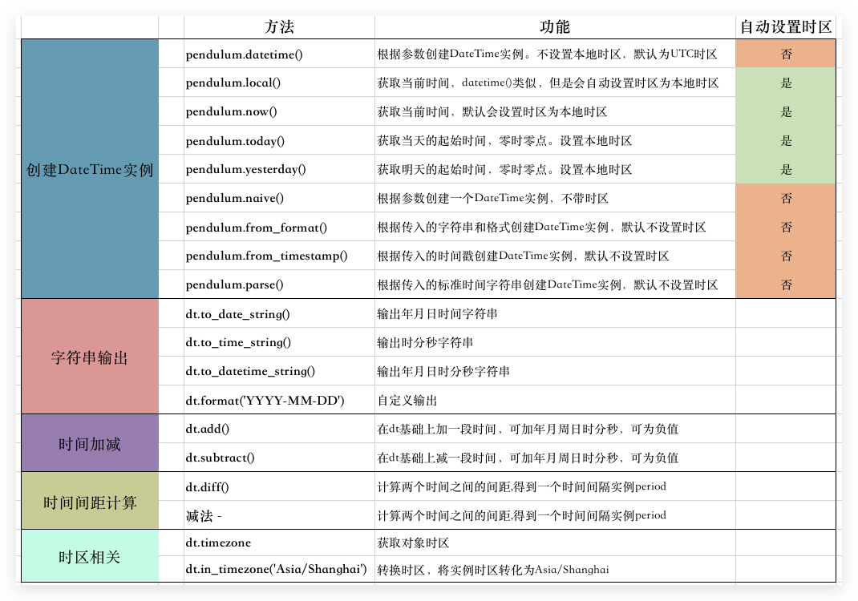
Pendulum
Pendulum is a Python package to ease datetimes manipulation.
It provides classes that are drop-in replacements for the native ones
Exercise: ./test/timezone/pendulum-ex.py
ex-1=> Drop-In Replacement to datetime
ex-2=> Timezones
ex-3=> Timezones, compare with diff TZ
ex-4=> Datetime Parsing
ex-5=> String Formatting
ex-6=> Human Readability
ex-7=> Find Relative Datetime-relativedelta
ex-8=> Find Relative Datetime-timedelta
ex-9=> Find Relative Datetime-timedelt
https://pendulum.eustace.io/docs/ https://iter01.com/616005.html
https://towardsdatascience.com/pendulum-one-of-the-most-useful-python-libraries-you-have-ever-seen-e2ecc365c8c0

Slide 27
Agenda – Architecture: Scheduler: Timezone
Background
Time zone introduction
Time zone in computer system
Time zone in Python
Time zone in Airflow
Time zone special issue
Q&A

Slide 28
Time zone in Airflow
Airflow background
User Interface
Default time zone
Time zone aware DAGs
Variable/ Jinja Templating / Macro
SQLG planner - xsl
https://airflow.apache.org/docs/apache-airflow/stable/timezone.html
Notes:
***

Slide 29
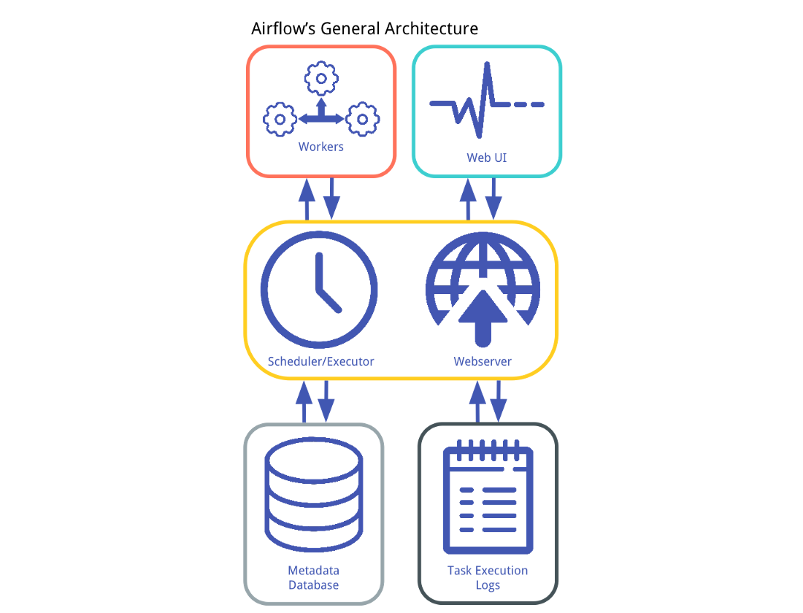
Background - Architecture
Metadata Database:
It stores information regarding the state of tasks
Scheduler:
A process that uses DAG definitions in conjunction with the state of tasks in the metadata database to decide which tasks need to be executed.
Executor:
The Executor is a message queuing process that is tightly bound to the Scheduler and determines the worker processes that actually execute each scheduled task.
Workers:
These are the processes that actually execute the logic of tasks

Slide 30
The IoC container: - scheduler in data pipeline application
The DIP principle
Vs. Structured Analysis and Design.
Break into component
is a first-class combination of the Open Closed Principle and the and the Liskov Substitution Principle
states:[1]
High-level modules should not import anything from low-level modules. Both should depend on abstractions (e.g., interfaces).
Abstractions should not depend on details. Details (concrete implementations) should depend on abstractions.
Dependence Inversion is about the shape of the object upon which the code depends.
Dependency Injection
Dependency Injection is about how one object knows about another, dependent object.
Inversion of Control
Inversion of control is about who initiates messages.
This is also referred to as Hollywood's Law; don't call me, I'll call you.
Relationship
For application design
DI is about how one object acquires a dependency.
IoC is about who initiates the call.
DIP is about the level of the abstraction in the messages sent from your code to the thing it is calling.
DI is about wiring, IoC is about direction, and DIP is about shape.
Example, a Monopoly game need read Monopoly board from storage
inject a JDBC connection: an incidental dependency, lower than the domain of the problem.
inject a Board Repository: meet the the domain of the problem in DIP.
https://martinfowler.com/articles/dipInTheWild.html
https://medium.com/lumiata/the-dependency-inversion-principle-an-application-in-airflow-pipelines-8f8ffbd2d274 https://www.tutorialsteacher.com/ioc/introduction
Notes:
When a dependency is provided externally, then the system is using DI.
https://www.grahambrooks.com/software-development/2016/07/11/dependency-inversion.html

Slide 31
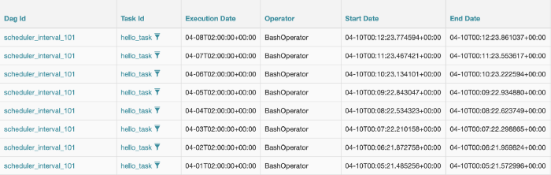
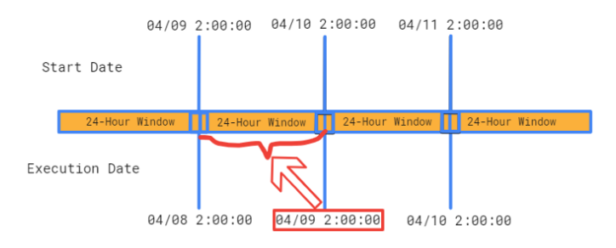
Background - Plan Example, logical date
start a new job at 2:00 a.m. every day.
Start date: 04–10 00:05:21 (UTC) , Run catchup
Airflow is built with an ETL mindset, which is usually a batch processing that runs 24 hours.
we don’t see the execution_date on 04–09 is because 24 hours window has not been closed yet.
the execution_date would be close to the previous start_date
dag = DAG(
dag_id='scheduler_interval_101',
schedule_interval='0 2 * * *',
default_args=args,
tags=['example']
)

Slide 32
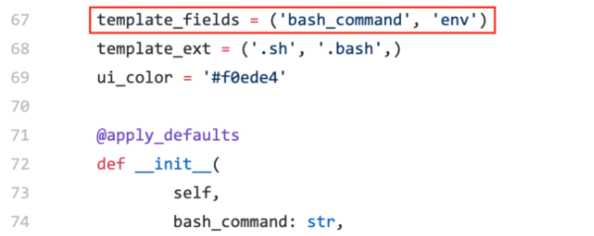
Background - Templating
Airflow defines which parameter can be templated or not. All parameters can’t be templated. except for:
At the documentation, (templated) is marked
bash_command (str) – The command, set of commands or reference to a bash script (must be ‘.sh’) to be executed. (templated)
Looking at the source code of the operator.
The variable for which we are interested is “template_fields”. This variable indicates which parameters are templated.
the “template_ext” variable defines which file extensions to look for in the templated fields.
templated_command = """
{% for i in range(5) %}
echo "{{ ds }}"
echo "{{ macros.ds_add(ds, 7)}}"
echo "{{ params.my_param }}"
{% endfor %}
"""
t3 = BashOperator(
task_id='templated',
depends_on_past=False,
bash_command=templated_command,
params={'my_param': 'Parameter I passed in'},
dag=dag,
)

Slide 33
Background - Scheduling term
Cron Presets:
Each DAG has a schedule (schedule_interval) defined in a cron expression as a str, or a datetime.timedelta object.
Data Interval: after 2.2
represents the time range for which a DAG run operates on a task.
data_interval_start = Start date of the data interval = execution date.
data_interval_end = End date of the data interval.
Logical Date:
The logical date of a DAG run is the same as the start of the data interval (data_interval_start).
It’s a replacement to the original “execution_date” which became confusing when you would execute multiple DAG runs.
Timetable: after 2.2
defines the schedule interval of DAG
Run After:
Run after represents the earliest time a DAG can be scheduled by the user.
Catchup:
executes a DAG run for any interval that has not been run
Backfill:
re-run DAGs on historical schedules manually.
Re-Run Tasks:
re-execute your failed tasks by setting the current task instance state to “None”.

Slide 34
Background - Cron Presets and Expressions
Airflow standard
SQLG
Default: defined in code page for
Manual update in UDFF {calendar}
Preset | Meaning | Cron
None | Don’t schedule, use for exclusively “externally triggered” DAGs
@once | Schedule once and only once
@hourly | Run once an hour at the beginning of the hour | 0 * * * *
@daily | Run once a day at midnight | 0 0 * * *
@weekly | Run once a week at midnight on Sunday morning | 0 0 * * 0
@monthly | Run once a month at midnight of the first day of the month | 0 0 1 * *
@yearly | Run once a year at midnight of January 1 | 0 0 1 1 *
Freq-DI | Airflow
D | 0 5 * * *
B | 0 5 * * *
W | 0 5 * * 0
M | 0 5 1 * *
I | @once
Y | 0 5 1 1 *
H | @hourly
# ┌─────── minute (0 - 59)
# │ ┌────── hour (0 - 23)
# │ │ ┌───── day of the month (1 - 31)
# │ │ │ ┌───── month (1 - 12)
# │ │ │ │ ┌──── day of the week (0 - 6) (Sunday to Saturday;
# │ │ │ │ │ 7 is also Sunday on some systems)
# * * * * *

Slide 35
Background - Sample R&R
Function Area | Standard | SQLG
DAGs | Anyone | SQLG Planner
“Operator” abstractions | Data engineers | SQLG Planner
Apache Airflow | Devops / Data engineers | SQLG Planner
OS + libs + sys config | Devops | SQLG
Hardware | Infra | Infra

Slide 36
Timezone in Airflow
Principle
Airflow stores datetime information in UTC internally and in the database.
Airflow does not convert them to the end user’s time zone in the user interface. It will always be displayed in UTC there.
Templates used in Operators are not converted.
Even only one time zone, it is still good practice to store data in UTC for Daylight Saving Time (DST).
Airflow uses time zone aware datetime objects.
Web UI
“Local” is detected from the browser’s timezone.
The “Server” value comes from the default_timezone setting in the [core] section.
The users’ selected timezone is stored in LocalStorage so is a per-browser setting.
Set UI default timezone by change default_ui_timezone in the [webserver] section to either an empty string, or the same value.
https://airflow.apache.org/docs/apache-airflow/stable/timezone.html

Slide 37
Time zone aware DAGs
DAG
Just make sure to supply a time zone aware start_date using pendulum.
The DAG timezone or global timezone (in that order) will always be used to calculate data intervals. Upon first encounter, the start date or end date will be converted to UTC using the timezone associated with start_date or end_date, then for calculations this timezone information will be disregarded.
Templates
Airflow returns time zone aware datetimes in templates, but does not convert them to local time so they remain in UTC.
Cron schedules
Time zone aware DAGs that use cron schedules respect daylight savings time.

Slide 38

企業資料模型轉換
ETL Job Planning
Ext Job Flow
Ext Steps
Data Inventory(PDM)
Logical 2 PDM
Internal Entity*
Data Model(LDM)
Common Type
Fundamental
Associative
Model Specific Type
Anchor
Supportive
Temp Table
Stored Proc.
View
PDM 2 Flow
5.0
4.0
3.0
2.0
6.0
1.0
作業資料模型
ETL 任務模型
分析資料模型

Slide 39
ETL日期變數 -可定義於程式內容或指令行中使用
內部變數名稱 | 說明(Format) | 格式 | Stored Procedure Version
{{START.DT}} | 資料起日(DATE) | YYYY-MM-DD | sqlext.STARTDT({{END.DT.CHAR}})
{{START.DT.CHAR}} | 資料起日(CHAR) | YYYYMMDD | sqlext.STARTDTCHAR({{END.DT.CHAR}})
{{END.DT}} | 資料迄日(DATE) | YYYY-MM-DD | sqlext.ENDDT({{END.DT.CHAR}})
{{END.DT.CHAR}} | 資料迄日(CHAR) | YYYYMMDD | END_DT_CHAR
{{MN.BEG.DT}} | 資料當月1號(DATE) | YYYY-MM-01 | sqlext.MNBEGDT({{END.DT.CHAR}})
{{MN.BEG.DT.CHAR}} | 資料當月1號(CHAR) | YYYYMM01 | sqlext.MNBEGDTCHAR({{END.DT.CHAR}})
{{MN.END.DT}} | 資料當月月底日(DATE) | YYYY-MM-DD | sqlext.MNENDDT({{END.DT.CHAR}})
{{MN.END.DT.CHAR}} | 資料當月月底日(CHAR) | YYYYMMDD | sqlext.MNENDDTCHAR({{END.DT.CHAR}})
{{LST.BZ.DT}} | 資料日上一營業日(DATE) | YYYY-MM-DD | sqlext.LSTBZDT({{END.DT.CHAR}})
{{LST.BZ.DT.CHAR}} | 資料日上一營業日(CHAR) | YYYYMMDD | sqlext.LSTBZDTCHAR({{END.DT.CHAR}})
{{NXT.BZ.DT}} | 資料日下一營業日(DATE) | YYYY-MM-DD | sqlext.NXTBZDT({{END.DT.CHAR}})
{{NXT.BZ.DT.CHAR}} | 資料日下一營業日(CHAR) | YYYYMMDD | sqlext.NXTBZDTCHAR({{END.DT.CHAR}})
{{MN.BEG.BZ.DT}} | 資料當月第一個營業日(DATE) | YYYY-MM-DD | sqlext.MNBEGBZDT({{END.DT.CHAR}})
{{MN.BEG.BZ.DT.CHAR}} | 資料當月第一個營業日(CHAR) | YYYYMMDD | sqlext.MNBEGBZDTCHAR({{END.DT.CHAR}})
{{MN.LST.BZ.DT}} | 資料當月月底營業日(DATE) | YYYY-MM-DD | sqlext.MNLSTBZDT({{END.DT.CHAR}})
{{MN.LST.BZ.DT.CHAR}} | 資料當月月底營業日(CHAR) | YYYYMMDD | sqlext.MNLSTBZDTCHAR({{END.DT.CHAR}})
{{CURRENT.DATE}} | 目前執行日期 | YYYY-MM-DD | sqlext.CURRENTDATE({{END.DT.CHAR}})
{{CURRENT.DATE.CHAR}} | 目前執行日期(CHAR) | YYYYMMDD | sqlext.CURRENTDATECHAR({{END.DT.CHAR}})
{{CURRENT.MONTH}} | 目前執行月份 | YYYY-MM-01 | sqlext.CURRENTMONTH({{END.DT.CHAR}})
{{CURRENT.MONTH.CHAR}} | 目前執行月份(CHAR) | YYYYMM01 | sqlext.CURRENTMONTHCHAR({{END.DT.CHAR}})
{{CURRENT.YEAR}} | 目前執行年 | YYYY | sqlext.CURRENTYEAR({{END.DT.CHAR}})

Slide 40
Exercise
C:> up 2
B> Check log
Test:
.\dags\sqlg_dag_SAL1.py
.\dags\jesse_dag.py
Configuration:
air-job-v2.0.cfg
Rerun Planner

Slide 41
Agenda – Architecture: Scheduler: Timezone
Background
Time zone introduction
Time zone in computer system
Time zone in Python
Time zone in Airflow
Time zone special issue
Q&A

Slide 42
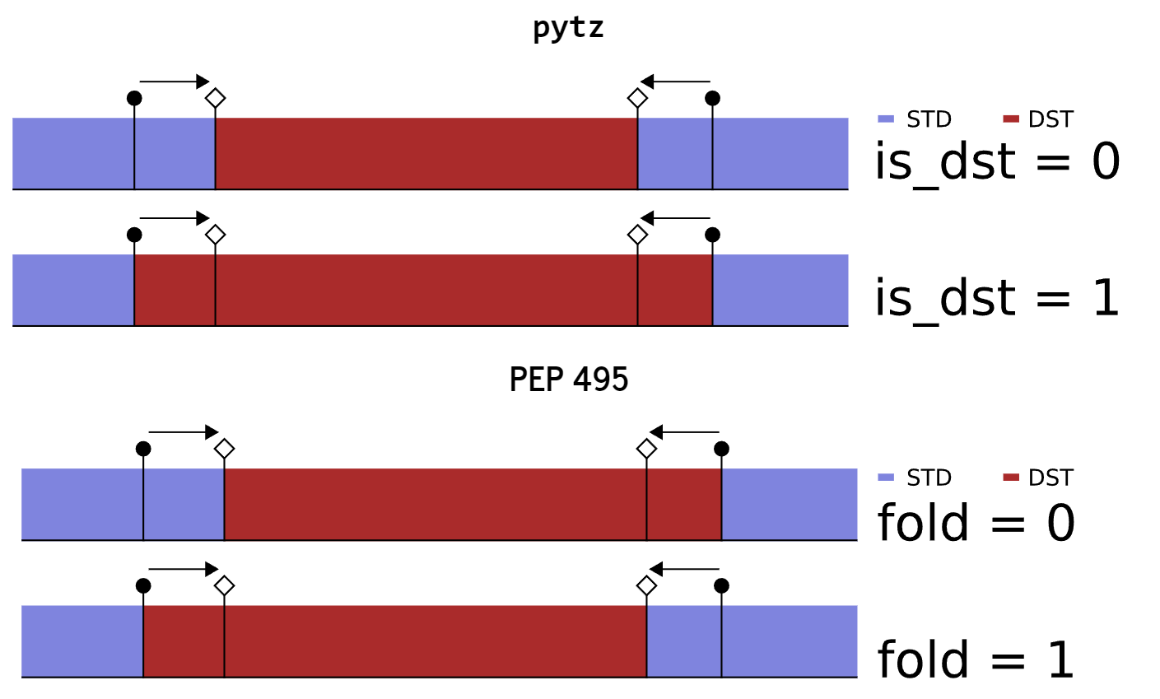
Time zone special issue
Timezone
Daylight Saving Time (DST)
clocks back (usually one hour) every Fall
PEP 495: Local Time Disambiguation
When clocks are moved back, we say that a fold [2] is created in time. When the clocks are moved forward, a gap is created.
Leap second
Historical time zones
"Pythonic" code may use Python idioms well, be natural or show fluency in the language, or conform with Python's minimalist philosophy and emphasis on readability.
"PEP 20 – The Zen of Python“
>> import this

